Slide 1
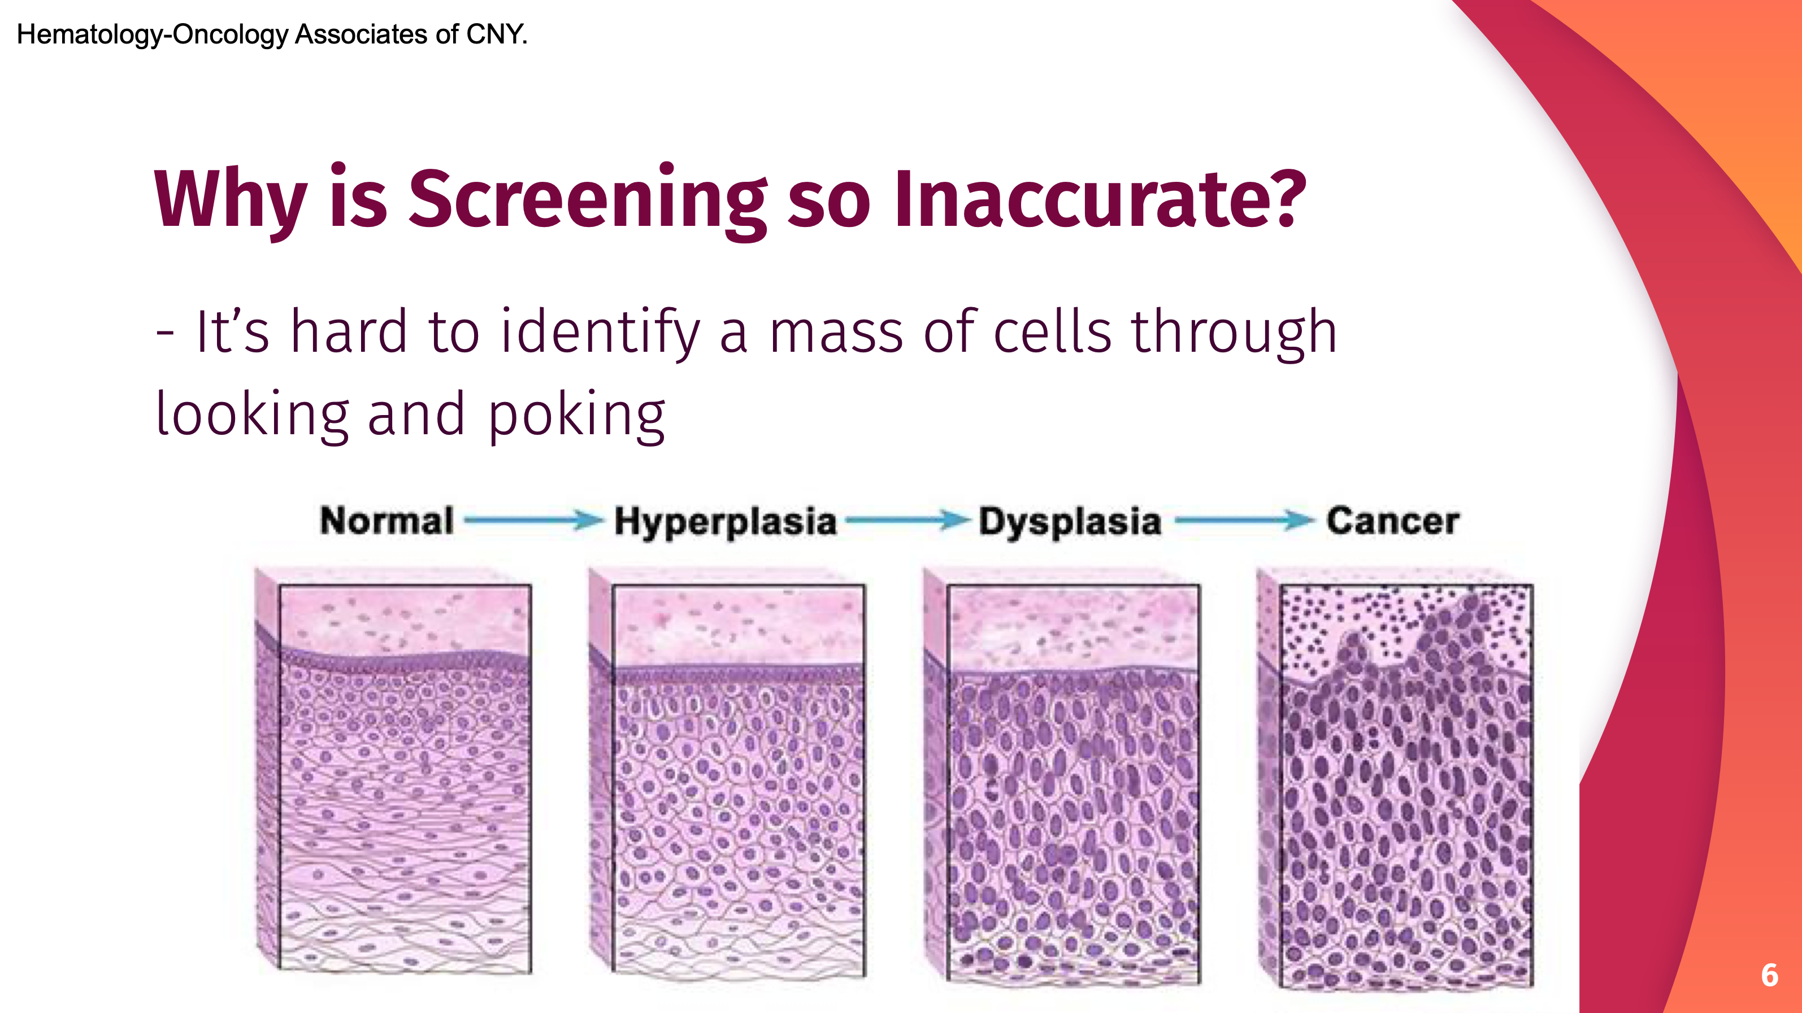
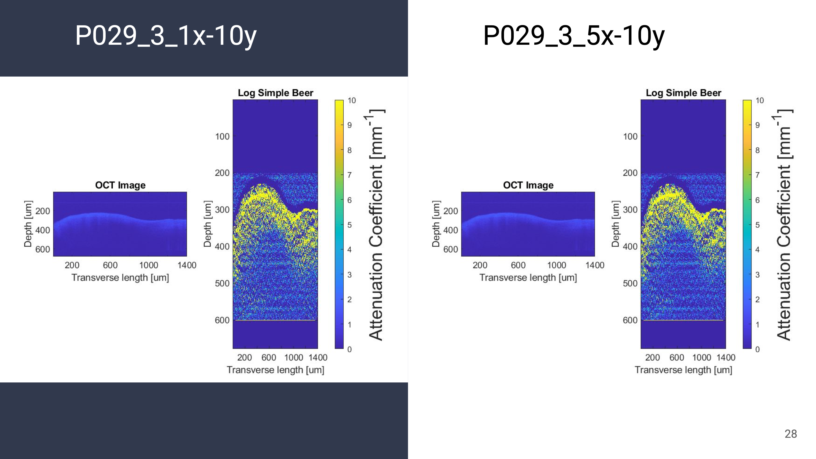
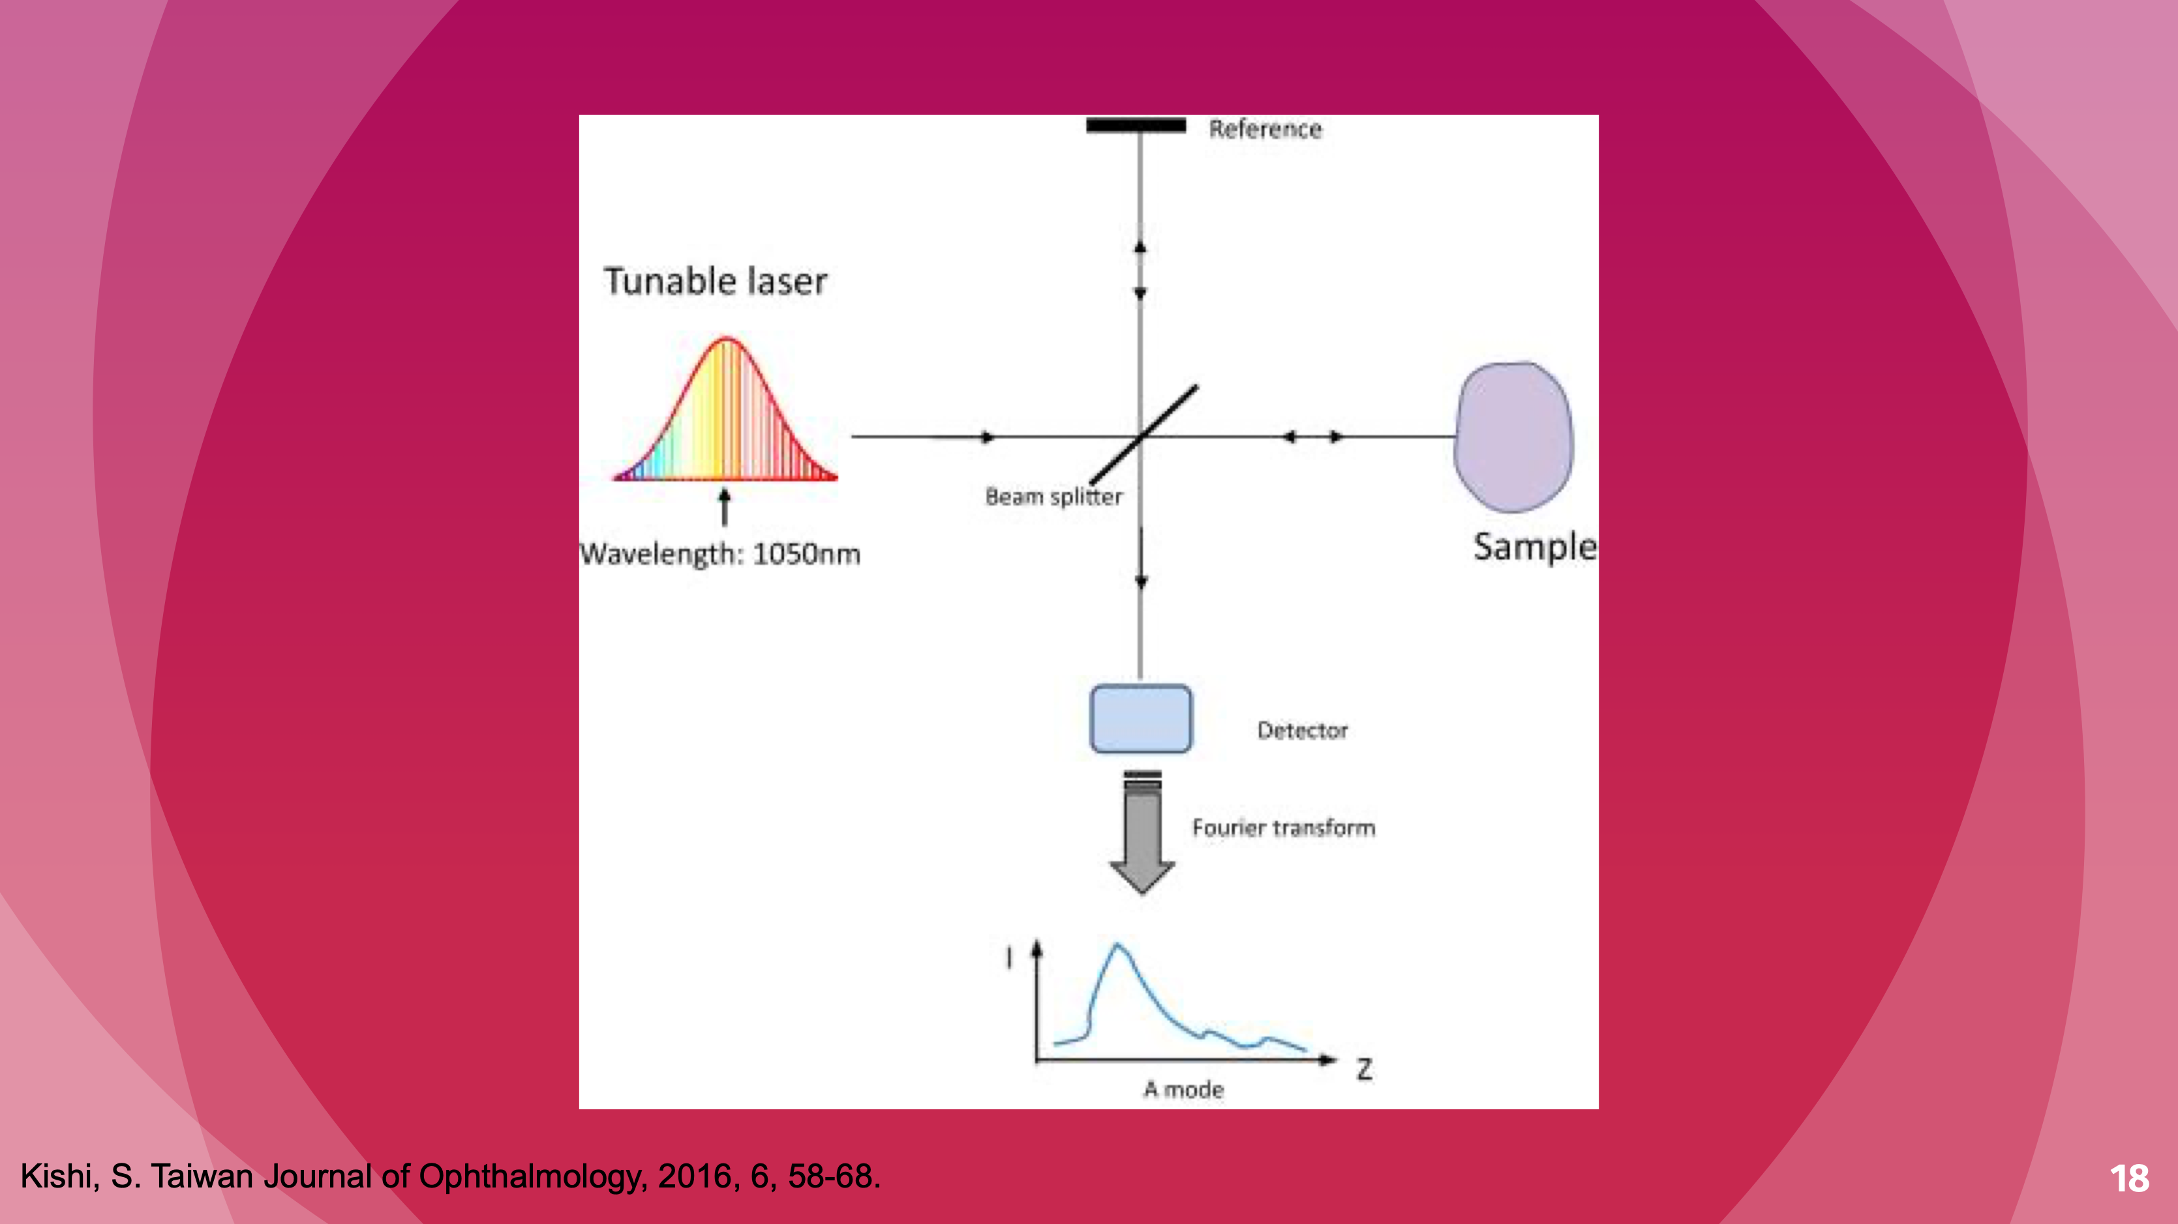
Shedding Light on Oral Cancer
Optical Coherence Tomography (OCT)

Slide 2
Cancer is terrifying. But not just because it can kill you. Cancer is terrifying because sometimes, it can progress for years before symptoms develop and the cancer is detected. This is exactly the problem with oral cancer. Right now, our screening methods for catching it are simply inadequate. (20s)
Current screening methods typically involve a visual examination of the mouth, with some poking and prodding. Followed by a biopsy and additional tests. Now, this is a lot of steps, and a lot of visits to the dentist over a long period of time. And the worst part is that the results they provide are ambiguous and not entirely accurate. In fact, they are ineffective at detecting cancer during its earlier stages. Because of these limitations, it has been said that routinely screening for oral cancer just hasn’t been proven to save any lives. (47s)
My project seeks to use an imaging technology Optical Coherence Tomography, or OCT, for detecting oral cancer. OCT is a medical imaging technology that is already used in the field of ophthalmology for obtaining images of the retina.
Here is the procedure. A biopsy of the suspicious tissue is collected form a patient’s mouth. Then the tissue is scanned using OCT by shining a ray of light that penetrates into the tissue and sends back data on its structural properties. Finally we are creating a program that takes the image data and mathematically computes a measurement. And this can be compared to result we would expect from normal tissue and what we might see in cancerous tissue. By getting a quantitative measurement, we can precisely and unambiguously discover cancerous structures in oral tissue even at its earliest stages. (1m 5s)
All it takes is a simple non-invasive scan. The main goal with this project is to use OCT as a quantitative method for finding cancers. This will make screening for oral cancer more accurate and easier. And because it can catch cancer so early in its development, we have a much greater chance of saving lives. (31s)

